Slide 1
Atlas Administration API and Tools Overview

Slide 2

Atlas Administration API
The Atlas Administration API follows the REST architecture to provide programmatic access to various features.
What do you understand by REST?
Atlas Resources
Atlas REST API
Shell
Tools
Apps
Notes:
The Atlas Administration APIs follow REST principles.
Various database resources and features, such as clusters, database users, and performance advisor are represented as API resources.
These resources can be accessed by corresponding API endpoints.
An endpoint may have various purposes, and the purpose is determined by the type of request.
For example, a POST request on the clusters endpoint creates a cluster, and a GET request on the same endpoint fetches clusters of a project.
So you may understand it as - an endpoint may perform a different operation depending on the HTTP verb passed in the HTTP Request (more about verbs in later slides)
An example of an endpoint: https://cloud.mongodb.com/api/atlas/v1.0/groups/60016b68683d41792455653e/clusters/
In the above endpoint, the resource name is clusters.

Slide 3
REST Verbs
POST | Used for creating resources (insert data) Payload can be sent in the request body
PUT | Used for replacing resources or collections (update data) Payload can be sent in the request body
DELETE | Used for deleting resources
PATCH | Used for updating resources with partial JSON data
GET | Used for retrieving resources Does not have a request body

Slide 4
REST Status Codes
200 OK | The request was successful This is typically the response to a successful GET request
201 Created | A new resource was created This is typically the response to a successful POST request
400 Bad Request | Something was wrong with the client’s request
401 Unauthorized | Authentication is required but not present in the request
405 Method not allowed | The HTTP method is not supported for the resource

Slide 5

cURL
cURL is a command-line tool to transfer files and data over the network
You can perform all the REST operations such as GET, POST, PUT, DELETE, PATCH using cURL

Slide 6
API Authentication

Slide 7

API keys in Atlas
The Atlas Administration API is:
Secured by a secret key
Restricted to specific ranges of IP addresses for additional protection
Enabled at two levels:
Organization level
Project level

Slide 8
API keys
To work with the Atlas Administration APIs, you need:
Public key - like a username
Private key - like a password
These are passed as a single string in the cURL command
The API uses HTTP digest authentication
> curl --digest -u "<public-key>:<private-key>" <EndPoint>

Slide 9
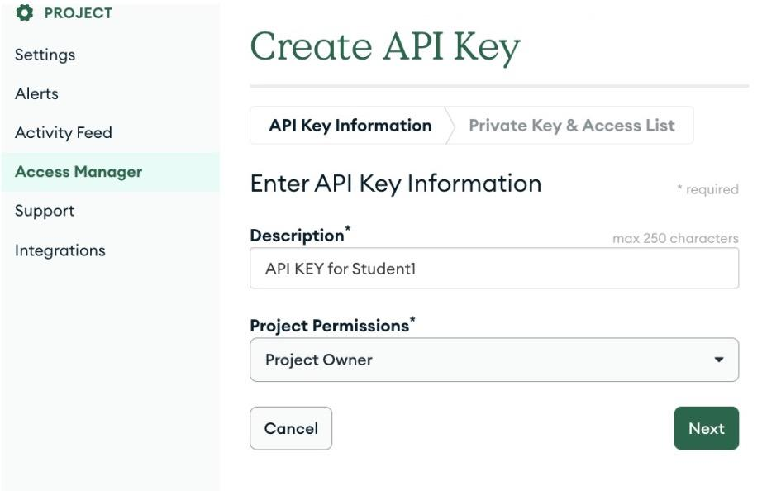
Create an API key
Create a key, on the API Keys tab:
Click Access Manager, Project Access
Click Create New API Key
Copy the Public Key
Enter a Description
Select Project Owner in the Project Permissions dropdown
Click Next
Copy the Private Key

Slide 10
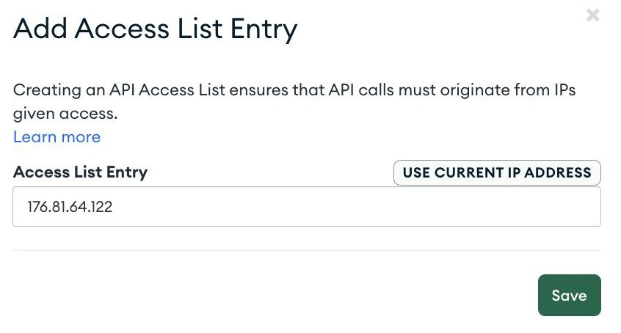
Create an API key- Network Access
Only those machines whose IP addresses are added in the Access List Entry can use the Atlas Administration APIs
You can enter a single IP or a CIDR Block

Slide 11
List Slow Queries
A GET operation on the performanceAdvisor/namespaces resource returns namespaces experiencing slow queries
It retrieves up to 20 collections
> curl -s --digest \
-u "nljqtalc:3330a6f8-349e-40c7-acca-4863771d0765" \
-H "Accept: application/vnd.atlas.2023-02-01+json" \
-X GET "https://cloud.mongodb.com/api/atlas/v2/groups/64a289b7a4ae6e11e6c9908d/processes/atlas-ggsqc5-shard-00-02.5qhvf.mongodb.net:27017/performanceAdvisor/namespaces?pretty=true"
{
"namespaces" : [ {
"namespace" : "sample_airbnb.listingsAndReviews_big_collection",
"type" : "collection"
}, {
"namespace" : "sample_airbnb.listingsAndReviews",
"type" : "collection"
}
...
]
}

Slide 12
List Slow Queries Logs
A GET operation on the performanceAdvisor/slowQueryLogs resource gets the log lines of the slow queries suggested by the Performance Advisor
> curl -s --digest \
-u "nljqtalc:3330a6f8-349e-40c7-acca-4863771d0765" \
-H "Accept: application/vnd.atlas.2023-02-01+json" \
-X GET "https://cloud.mongodb.com/api/atlas/v2/groups/64a289b7a4ae6e11e6c9908d/processes/atlas-ggsqc5-shard-00-02.5qhvf.mongodb.net:27017/performanceAdvisor/slowQueryLogs?pretty=true"
{
"slowQueries" : [ {
"line" : "2023-09-06T23:14:35.311+00:00 I COMMAND [conn4086] command sample_airbnb.listingsAndReviews_big_collection appName: \"MongoDB Shell\" command: find { find: \"listingsAndReviews_big_collection\", filter: { property_type: \"Palace\" }, lsid: { id: UUID(\"8f8d6155-252c-472c-867d-f85430909fef\") }, $clusterTime: { clusterTime: Timestamp(1611318127, 1), signature: { hash: BinData(0, 09B880DACC6BF162A919506A227122F4A8533475), keyId: 6920456473055068163 } }, $db: \"sample_airbnb\" } planSummary: COLLSCAN keysExamined:0 docsExamined:55550 cursorExhausted:1 numYields:434 nreturned:0 queryHash:DA9B14D0 planCacheKey:DA9B14D0 reslen:261 locks:
...
}]}

Slide 13
Get Suggested Index
A GET operation on the performanceAdvisor/suggestedIndexes resource gets the suggested index by the Performance Advisor
Why is it suggesting to create indexes on property_type?
> curl -s --digest \
-u "nljqtalc:3330a6f8-349e-40c7-acca-4863771d0765" \
-H "Accept: application/vnd.atlas.2023-02-01+json" \
-X GET "https://cloud.mongodb.com/api/atlas/v2/groups/64a289b7a4ae6e11e6c9908d/processes/atlas-ggsqc5-shard-00-02.5qhvf.mongodb.net:27017/performanceAdvisor/suggestedIndexes?namespaces=sample_airbnb.listingsAndReviews_big_collection&pretty=true"
{
"shapes":[{
...
}],
"suggestedIndexes" : [ {
"avgObjSize" : 16986.0,
"id" : "5ff6fd8c6854ab09f42467a8",
"impact" : [ "5ff6fd716854ab09f42463f1" ],
"index" : [{
"property_type" : 1
}],
"namespace":"sample_airbnb.listingsAndReviews_big_collection",
"weight" : 0.004500916672419352
} ]
}

